Slide 1
90 Day Plan

Slide 2
Agenda
Introduction
Background
Overview
Effort
Checklist
Categories: Three P’s
People
Products
Process
TimeLine: 30-60-90 Days
First 30 - Learn
Mid 30 - Clarify
Last 30 - Align
Summary

Slide 3
Introduction: Background
Why the first 90 Days?
First impressions count
You brand yourself during this time
Prioritization is critical
Risks of unstructured plan?
Poor prioritization
Miscommunication
Lack of organizational confidence
Wasted Resources
Ineffective lieutenants
Unhappy technology staff
Bottom line performance

Slide 4
Introduction: Overview
Three P’s
People: For each stage, the people you speak with and how to focus the varying conversations
Products: Products refers to anything that may be considered a deliverable of the IT department: applications, infrastructure, policies, support and so on.
Processes: Formal and Informal. Unstructured communications are as valuable as structured processes and procedures
90 Days
First 30: Learn - Emphasizes high level conversations and getting to know the new organization.
Middle 30: Clarify - Digging into details.
Last 30: Align – Establish what needs to be done, began the communication and building relationships.

Slide 5
Introduction: Effort
First 30
People – Heavy
Products – Light
Processes – Light
Middle 30
People – Light
Products – Heavy
Processes – Light
Last 30
People – Light
Products – Light
Processes – Heavy

Slide 6
Introduction: Checklist
†

Slide 7
Categories: “The Three Ps”
People, Products & Processes

Slide 8
Categories: Three P’s- People
Levels of Organization - Most organizations large enough to support a CIO/CTO have at least 3 categories of staff: Executives, Lieutenants and Individual Contributors
Executives
CEO
CxOs
Vice Presidents (SVPs)
Lieutenants
Directors
Managers
Line of Business (LOB) Leaders
Individual Contributors
Remote and/or offshore teams
Other People
Vendors / Partners
Consultants / Contractors
Similar Organizations
Regulators
Competitors
†

Slide 9
Categories: Three P’s- Products (Technology)
At the highest level, the key areas of Products to focus on include Infrastructure, Applications and Services…
Infrastructure
Workstations
Servers
Telecommunications
Applications
Desktop
Communication (Email, Chat, CRM, Telephony…)
Back Office (Accounting, Finance, Inventory, HR…)
Data Stores (DBs, Intranet, Knowledge Management…)
LOB Solutions (Engineering, Sales, Content Delivery…)
Services
Project Management
Application Delivery
Support / Maintenance
Outsourcing
Policies
* The Customer
Competitive Analysis (Internal sources, external sources, key clients, advisory boards, etc…)

Slide 10
Categories: Three P’s - Processes
Formal and Informal. Key here is knowing who to contact, when and how, both within IT and across the organization.
Budget
Tracking / Forecasting
Purchase Orders / Expenses
Project Intake (IT)
Prioritization
Change Management
Strategic Planning
Support
Accountability
Budget
IT Organization (Scorecards)
All other system and performance management

Slide 11
Timeline
First 30, Middle 30 and Last 30 Days

Slide 12
Timeline: First 30 Days - Learn
The first 30 days emphasizes high level conversations and getting to know the new organization.
Meeting with executives and technology staff while understanding the most critical products and immediately necessary processes is the goal.
Major Themes:
Research individuals
Carefully prepare questions
Be a sponge: listen, listen, listen and absorb
Document and structure feedback
Goals:
Get a feel for the organization
Understand critical products
Understand major pain points
Initial review of existing technology direction and/or roadmaps
Begin a task list to focus your energies in the first year

Slide 13
Timeline: First 30 Days - People
Heavy emphasis will be in this area
Three Main Questions
What has worked well and what has not?
What are the most urgent IT needs?
What are the re-occurring / cyclical needs?
Executives
Most senior executives (CxO, SVPs)
Technology Staff
Gather existing performance reviews & resumes
Meet with leadership and key personnel (as many as possible)
Which relationships are strong / weak (internal or external)
Understand responsibilities of each
Quick Alignment exercise: Individual<–>Job Title or Role<–>Day to day tasks
Identify key responsibilities by individual / team – Development, Operations, Support, Security

Slide 14
Timeline: First 30 Days - Products
Light emphasis in this area
Infrastructure
Network & Telecommunications
Network overview
Phone systems setup
Servers & Hosting
Number, types and ages of servers aligned by service
Hosting / Co-Lo / Cloud & SaaS providers overview
Workstation Environment
Numbers, models, ages
Mobile Solutions (PDAs, Wireless)
Applications
Desktop services
Communication
Line of Business solutions
Data Map overview
Services
Overview of all
Support / Maintenance
Project Management

Slide 15
Timeline: First 30 Days - Processes
Light emphasis in this area
Budget
Overview
Snapshot (Product too)
Project Intake (IT)
New requests (Forms, approval)
Strategic Planning
Technology Process
Support
Service Level Agreements (SLAs)
Request Methods (Hotline, email, chat, after hours)
Accountability
Budget Planning
SLA Tracking
Scorecard Tracking

Slide 16
Timeline: Middle 30 Days - Clarify
The middle 30 days emphasizes continued conversations with organization leaders and getting to know more of the Technology team.
There is an increased emphasis on the products at this point – learning what exists and why.. i.e. Digging into the details
Major Themes:
Meeting as many people as possible
Study the products in detail
Document and structure feedback
Goals
Action plan should be coming together
Capabilities Maturity / Matrix evaluation should be established
Initial financial model & budget information to work with in place
Have all documentation (or lack thereof) in place to validate your planning with the organization in the final 30 days.

Slide 17
Timeline: Middle 30 Days - People
Light emphasis will be in this area
Business Lieutenants
Directors, Managers
Same questions as executives
Technology Staff
Any remaining, as possible
Same questions, where applicable
Smaller Consultants / Contractors
Insights, feedback, plans

Slide 18
Timeline: Middle 30 Days - Products
Heavy emphasis will be in this area
Infrastructure
Network & Telecommunications
Network specifics (vendors, WAN acceleration, traffic prioritization)
Security specifics (perimeter, passwords, intrusion detection)
Servers & Hosting
Aging servers retirement plans
Capacity evaluation
Workstation Environment
Capacity evaluation
Applications
Line of Business solutions (details)
Data Map (details)
Back Office Suite Overview
Services
Application Development & Architecture
Outsourcing
†

Slide 19
Timeline: Middle 30 Days - Processes
Light emphasis will be in this area
Budget
Tracking
Purchase Orders / Expense
Project Intake (IT)
Prioritization
Support
SLAs – Internal
Accountability (Who, What, Where, When, Why, How)
Budget
IT Organization (Scorecards)
Performance Management

Slide 20
Timeline: Last 30 Days - Align
In the last 30 days you begin to leverage the knowledge you’ve obtained to ensure alignment of technology with business.
At this point you may also want to start reaching out to vendors, other external contacts, and expanding your network.
Major Themes:
Recurring meetings
Expanding network
Validating plans with leadership
Begin longer-term strategic plans
Goals:
You should have an understanding of the first year internal organization action plan.
You will want to validate these plans with leadership across the organization and once validate begin execution.
Begin your longer-term strategic plans.
External partners
Competitive Analysis (Internal sources, external sources, key clients, advisory boards, etc…)

Slide 21
Timeline: Last 30 Days - People
Light emphasis will be in this area
Executives
Establish recurring update / meeting schedule
Technology Staff
Establish recurring update / meeting schedule
Initial meetings with all remaining, as possible
Same questions, where applicable
Major Vendors / Partners
Leverage knowledge from previous conversations
What has gone well, what has not
Thoughts on pricing, contracts, future needs
CIOs/CTOs of Similar Organizations
Depending upon organization
Regulators
Leverage knowledge from previous conversations
Listen carefully

Slide 22
Timeline: Last 30 Days - Products
Light emphasis will be in this area
Infrastructure
Network & Telecommunications
Telecommunication contracts review
Servers & Hosting
Hosting / Co-Lo / SaaS providers – contracts, performance tracking
Capacity forecasting
Workstation Environment
Capacity forecasting
Applications
Standards (languages, vendors, disk capacity)
Back Office Suite Details (Integration, capacity, forecasting)
License audit / tracking
Services
Details of any remaining
Capacity forecasts
Policies

Slide 23
Timeline: Last 30 Days - Processes
Heavy emphasis will be in this area
Budget
Gap Analysis
Project Intake (IT)
Pending Projects
Strategic Planning - Align with Business
Change Management
Support
SLAs – External Tracking
Vendors
ITIL or Best Practices

Slide 24
Timeline: Summary

Slide 25
Timeline: Effort Allocations
First 30
People – Heavy
Products – Light
Processes – Light
Middle 30
People – Light
Products – Heavy
Processes – Light
Last 30
People – Light
Products – Light
Processes – Heavy

Slide 26
Timeline: After the 90 Days
Clear Prioritization List
Develop Year 1 Action Plan
Customer - Growth & Retention
Process
People
Financial
Validate Priorities with Business
Communicate Priorities to IT
Build Consensus Across IT
Communicate to Business
Begin Longer-term Strategic Planning

Slide 27
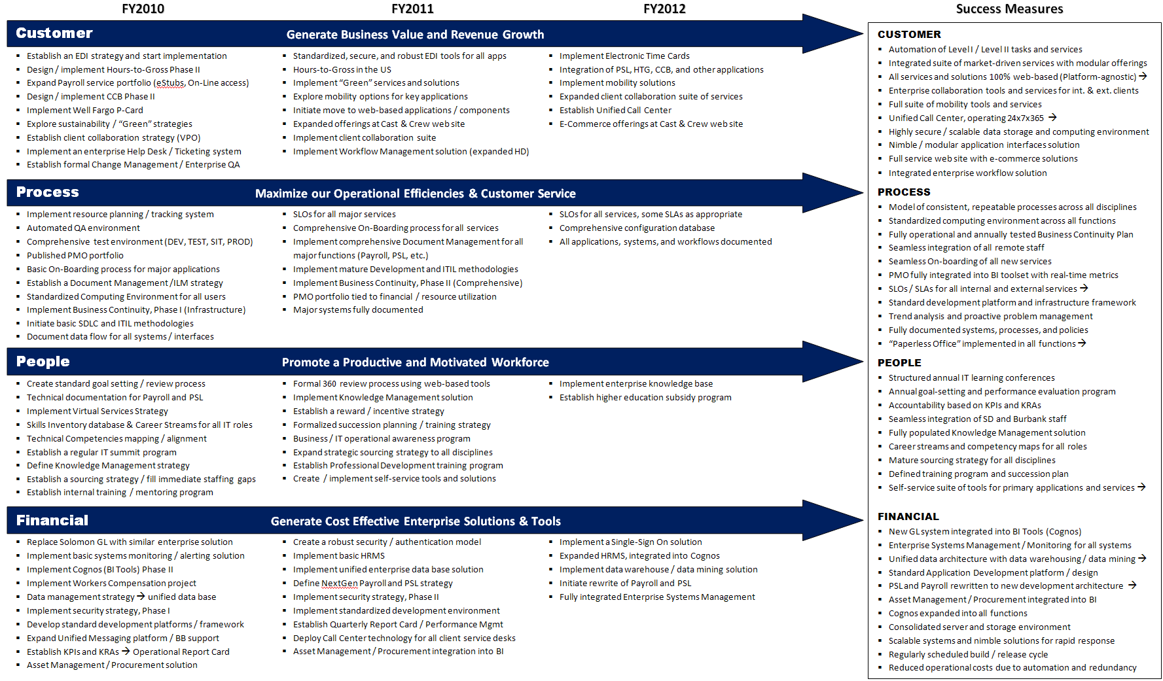
Timeline: After the 90 Days

Slide 28
A few more thoughts
Many “Ah-ha” and “Gotcha” moments will follow for a long time. Key is getting started on the right foot with a solid understanding across all major areas.
Never eat lunch alone* and never forget to schedule your lunch meetings.
Everything will be interpreted (sometimes too much), be sure you prioritize these steps and communicate in manner you want to relay.
Inform IT staff of some guideline to your plan, for example:
First 4 weeks, getting a grasp of basics
Next 4 weeks, digging into details
Over the next 8 weeks:
Series of meetings on IT Services

